Slide 1
Algorithm Analysis and Data Structures
Exercises
Pramote Kuacharoen

Slide 2
Currency Exchange: Part 1
Write a program that
Reads a name of the country
Displays the name of currency and the exchange rate for requested country
File: Exchrate.txt
File format: name of the country, name of currency, exchange rate/USD$

Slide 3
Average Miles per Gallon
Write a program that calculate average miles per gallon of car models
File: Mileage.txt
File format: model, gallons per 100 miles
100 / average

Slide 4
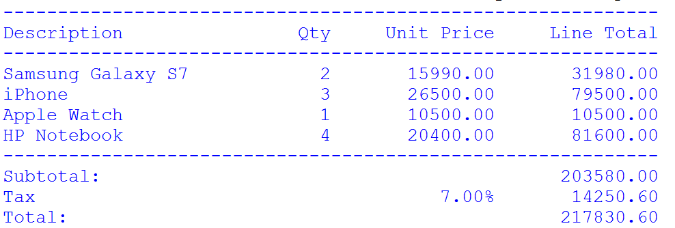
Invoice
Write a program to print an invoice
Write a function called sumproduct which
Accepts a list of description, quantity, price per unit
Returns total amount
Write a function called display_items
Accepts a list of description, quantity, price per unit
Displays description, price per unit, line total
Write a function called display_invoice
Accepts a list of description, quantity, price per unit
Print invoice
File format: description, quantity, price per unit
Order.txt

Slide 5
Point
Class Point
Instant variables: _x, _y
Getters and setters
Method __str__
Method distance_from_origin
Sqrt((x^2)+(y^2))

Slide 6
Stock
Class Stock
name, symbol, previous_price, current_price
Getters and setters
Method get_change_percent returns a string of percentage change

Slide 7
Wages
Class Wages
Instance variable: _name, _hours, _wage
__init__ mothod accepts name=“”, hours=0.0, wage=0.0
Getters and setter
Method payment
Returns the payment for the week
If hours > 40, the pay rate is 1.5 times the normal wage

Slide 8
Quiz Average Score
Class Quizzes
Method __init__ accepts a list of scores
Method average calculate the average by dropping the lowest quiz scores
Method __str__ returns a string of average
Function main
Reads a line of scores
Displays the average score

Slide 9
Dice
Class PairOfDice
Instant variables: _red_die, _blue_die
Method __init__ initializes variable to 0
Method get_red_die returns red die
Method get_blue_die return blue die
Method roll randomly selects red die and blue die
Method sum returns sum of red die and blue die
Function main

Slide 10
Probability
Determine the likelihood of obtaining 7 when rolling a pair of dice
You may do the experiment 100,000 times

Slide 11
Shopping
Class Purchase
description, price, quantity
getters and setters
Class Cart
List of Purchase items
Methods add_item, get_items, calculate_total
Function print_receipt
Function main
Asks for a Purchase item
Adds the Purchase item to the Cart
Calls print_receipt

Slide 12
Notebook
Notes are short memos stored in a notebook. Each note should record the day it was written and can have tags added for easy querying. It should be possible to modify notes. We also need to be able to search for notes. All of these things should be done from the command line.
notebook
---------------
note
------
getter
add_note
list_note_by_date
search_note
search_tag
show_command
note
---------------
date
content
tag
-------
getter
Setter

Slide 13
note

